Slide 1
Finance Chatbot
Alston Zeng
Notes:
Good evening everyone, we are Group 5
and today we are presenting our Finance Advising Assistant.

Slide 2
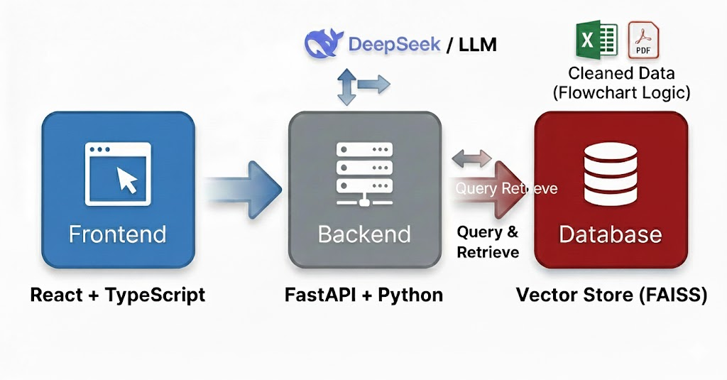

Slide 3
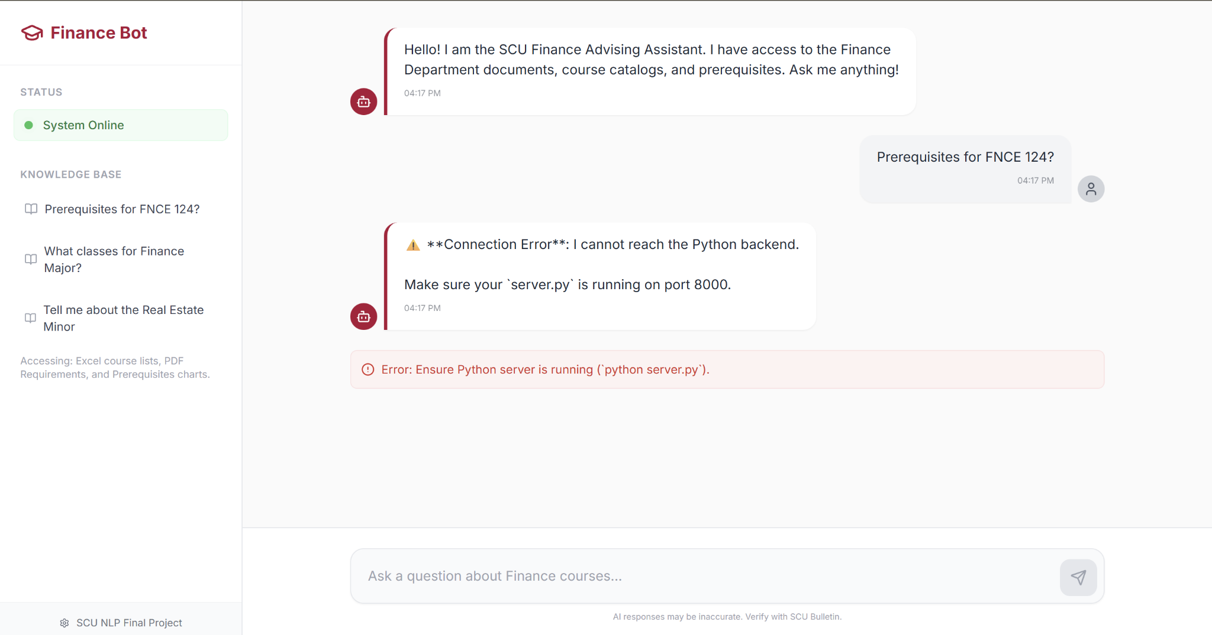
⚡ Reactive & Responsive
  Built with React + Tailwind CSS for a clean, academic look (matches SCU branding).
💬 Streaming Interaction
  Implemented "Typewriter effect" to reduce perceived latency.
🛡️ Error Handling
  Real-time connection status check (Alerts user if Backend is offline).

Slide 4
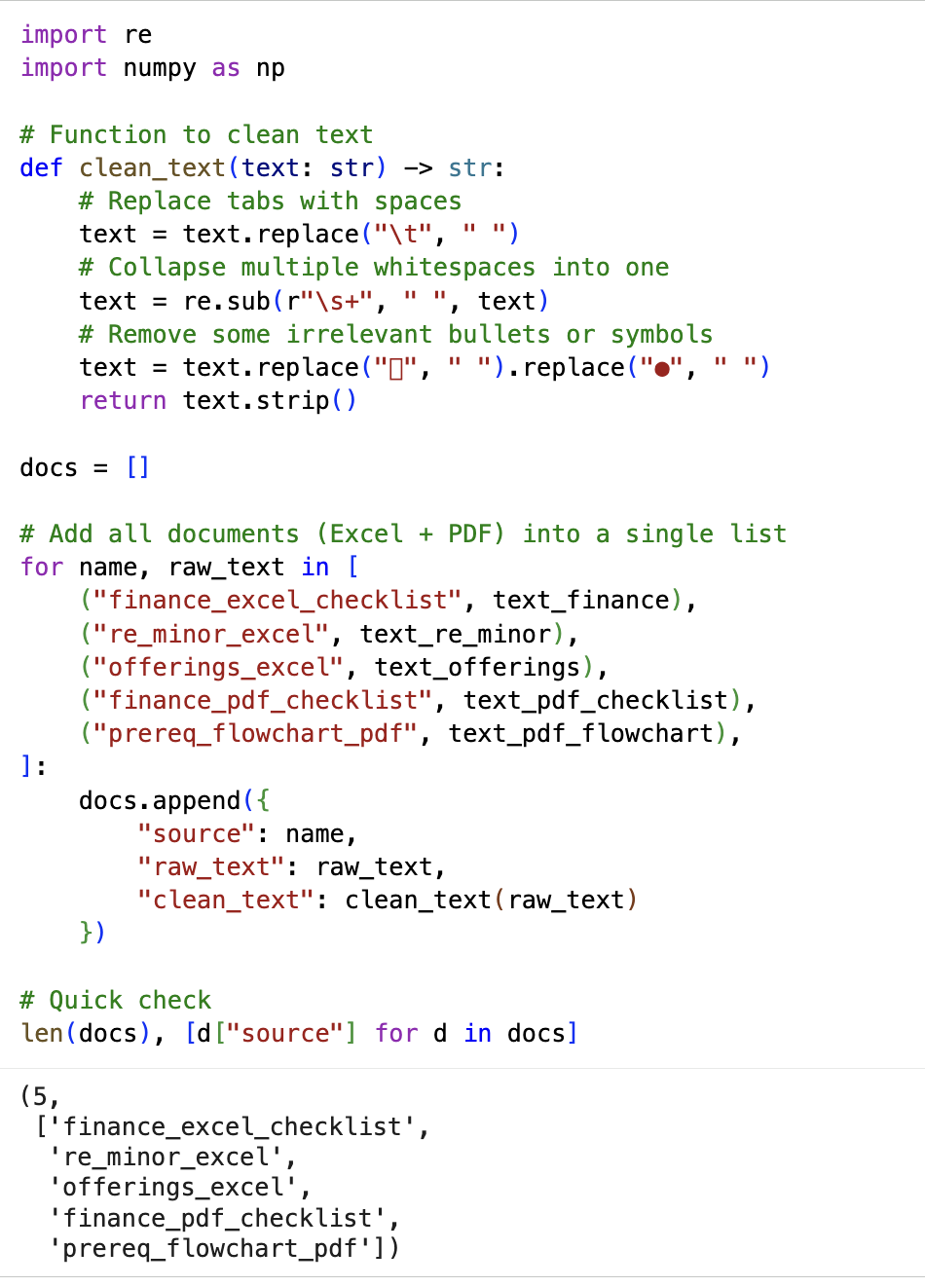
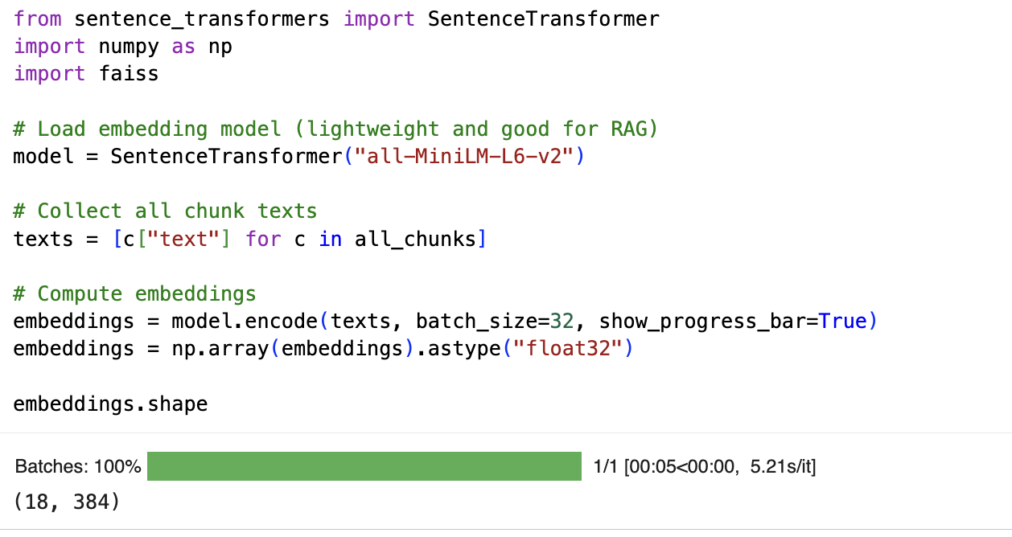
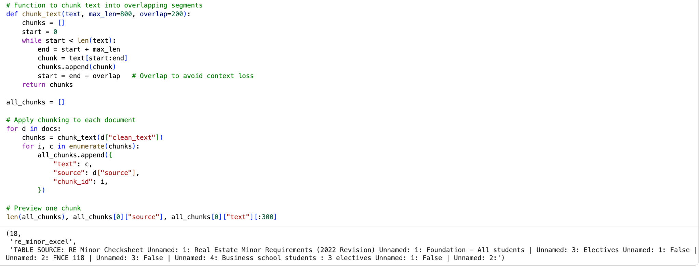
Data Processing and Chunking

Slide 5
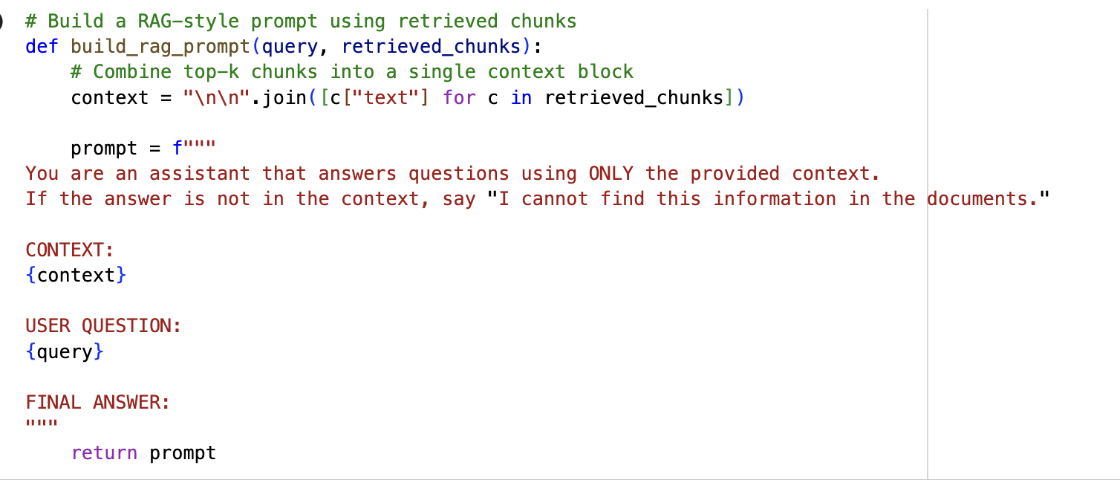
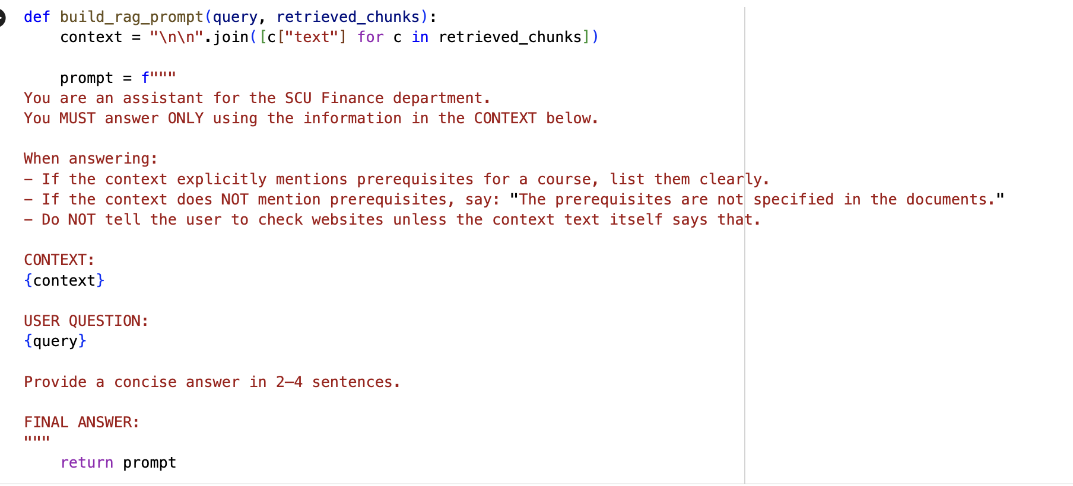
Prompt

Slide 6
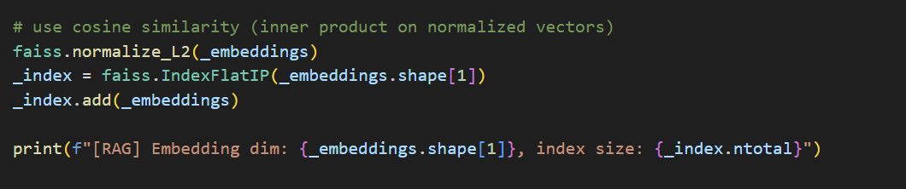
Vector Search with FAISS
Stored all embeddings in a FAISS L2 vector index.
For each user question:
Embed the query
Search for top-k similar chunks
Retrieved chunks serve as context for the answer.

Slide 7
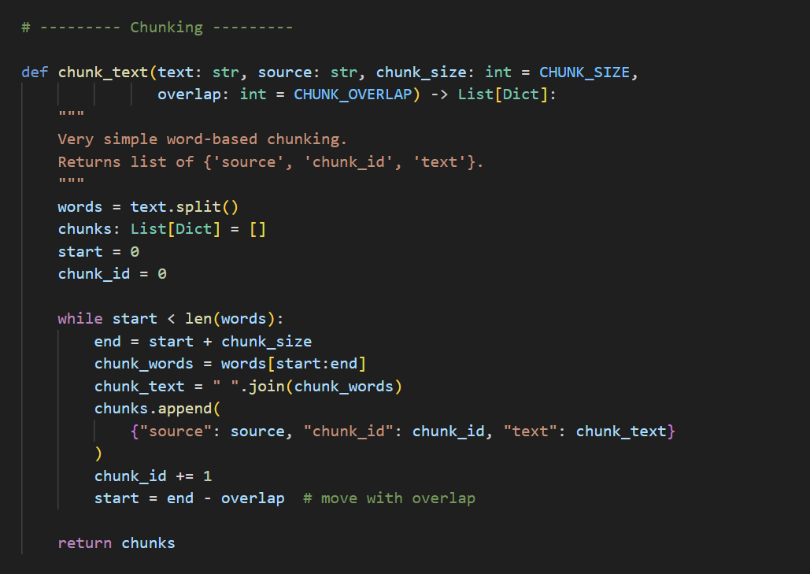
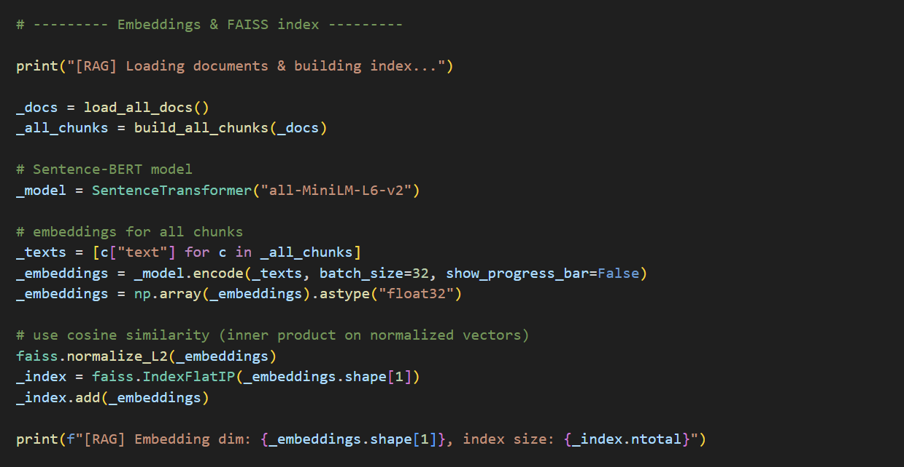
Chatbot with Retrieval-Augmented Generation
Built a domain-specific chatbot using a frontend–backend architecture.
Backend implements a full RAG pipeline.
Goal: ensure accurate answers grounded in our own documents.

Slide 8
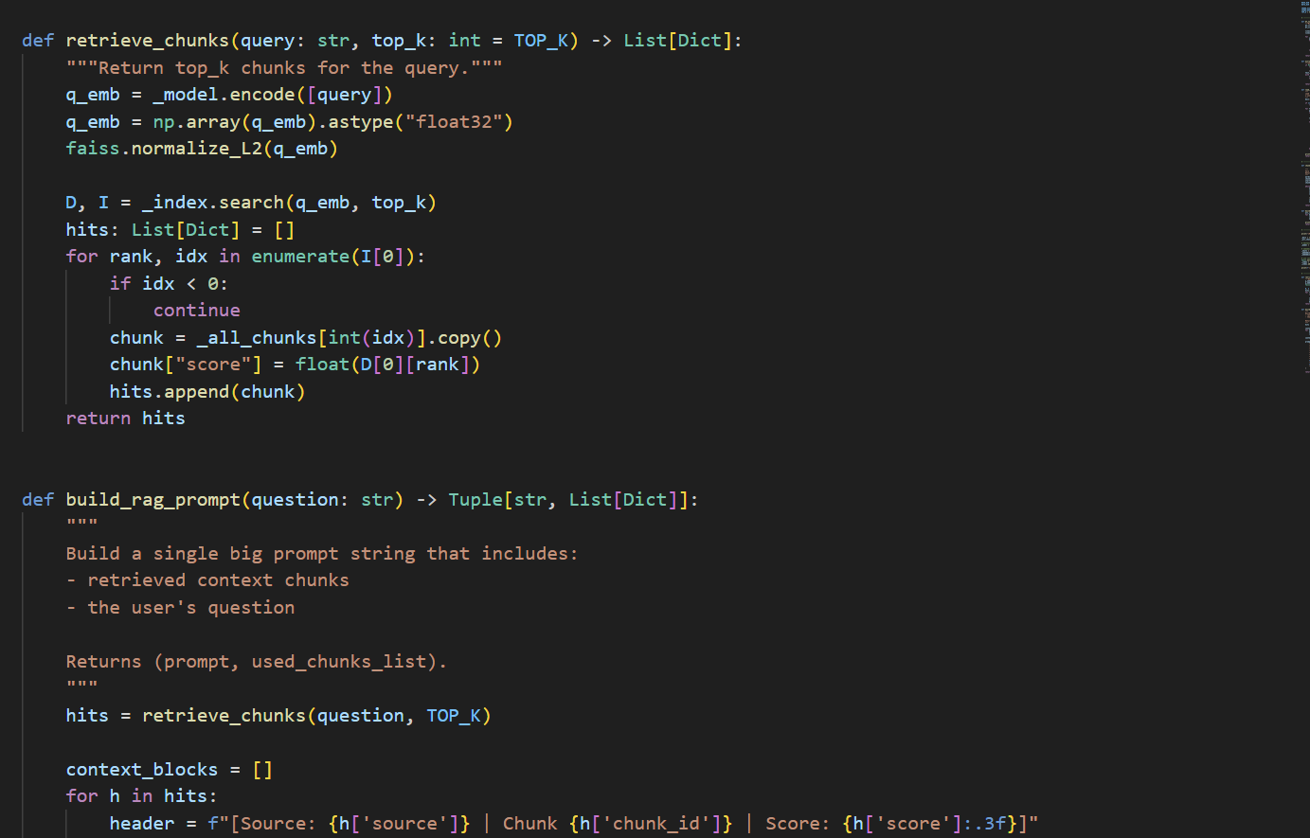

Slide 9
System Architecture
server.py handles the backend logic: runs the RAG pipeline, builds the prompt, calls DeepSeek-Chat, and returns the response to the frontend.

